Slide 1
Case Study
Sudesh

Slide 2
Question 1
Write an SQL statement to find the total number of user sessions each page has each day.

Slide 3
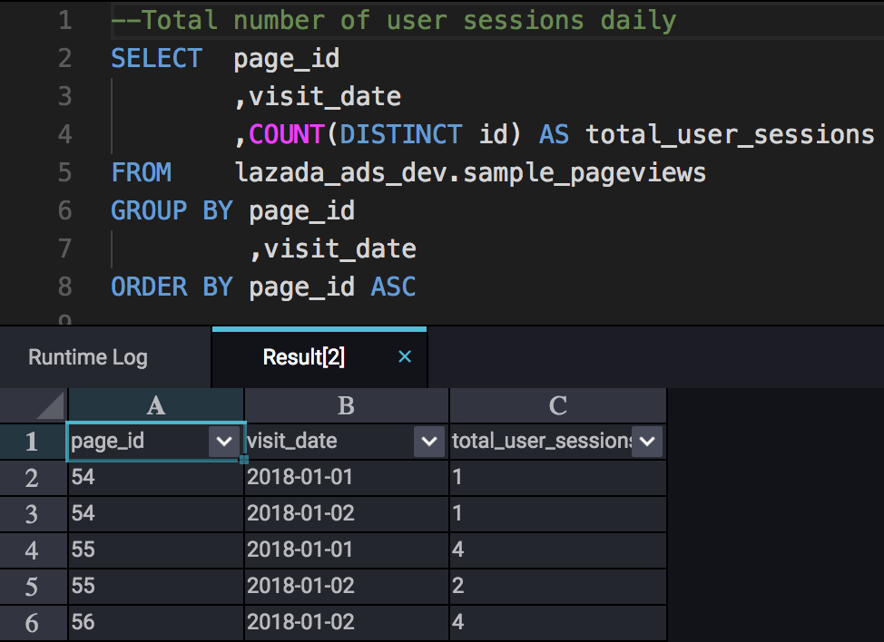
SQL for Question 1
Method:
Aggregate user sessions by counting id as 1 session is classified as 1 id.
Group by page id and visit date to get total number of page sessions daily.
Order by page id for data presentation purpose

Slide 4
Question 2
Part 1
Which month has the highest sales?
Is there any seasonality effect?

Slide 5
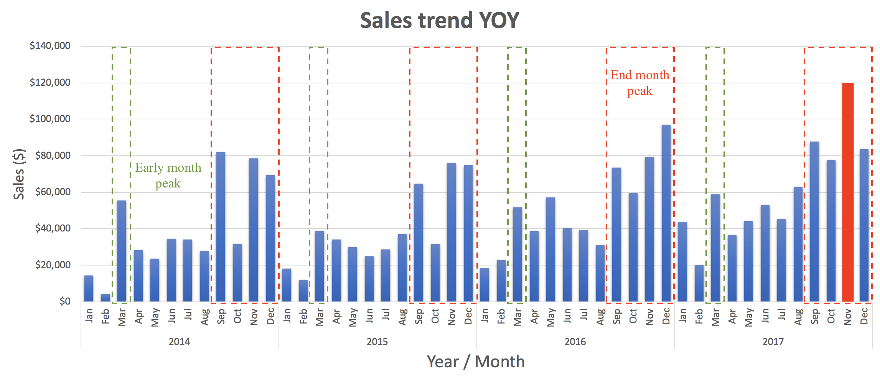
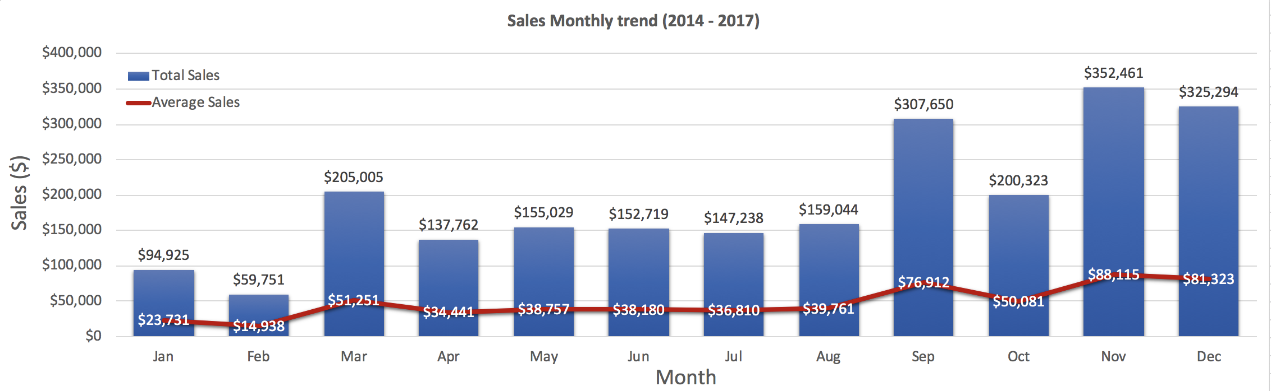
November 2017 has the highest sales with $118K
Highlights:
The month of November produces the highest sales with a yearly average of $88k and an accumulated total of $352k throught the 4 year period.
Highest recorded sales fell on Nov 2017 with $118k sales in total.
YOY Trend Summary:
Early Month (Jan – Apr)
The month March peaks the early month sales trend every year, due to early year campaigns.
Mid Month (May – Aug)
These months, the trend is very neutral YOY.
There was a spike in sales on May 2016 mainly contributed by the category electronics - printers.
End Month (Sep – Dec)
Contributes 52% of yearly sales.
End of year Campaign promotions and holiday season spikes up the sales trend during these period.

Slide 6
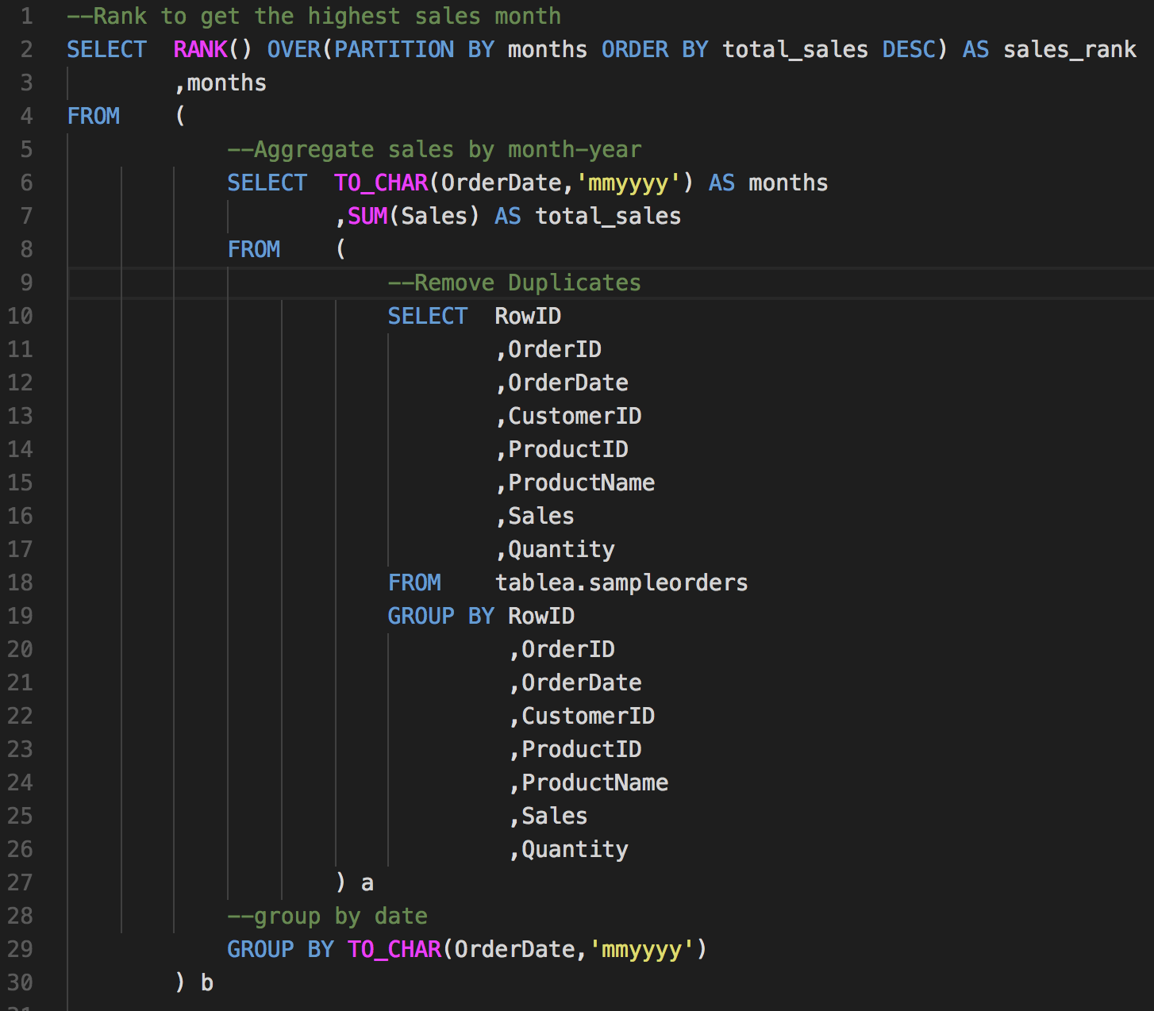
SQL for Question 2 (Part 1)
Method:
Group by all fields to remove duplicates
Convert OrderDate to Month-year
Aggregate sales by summing
Rank Month by highest sales to find highest selling month

Slide 7
Question 2
Part 2
Which product is the recent best seller?

Slide 8
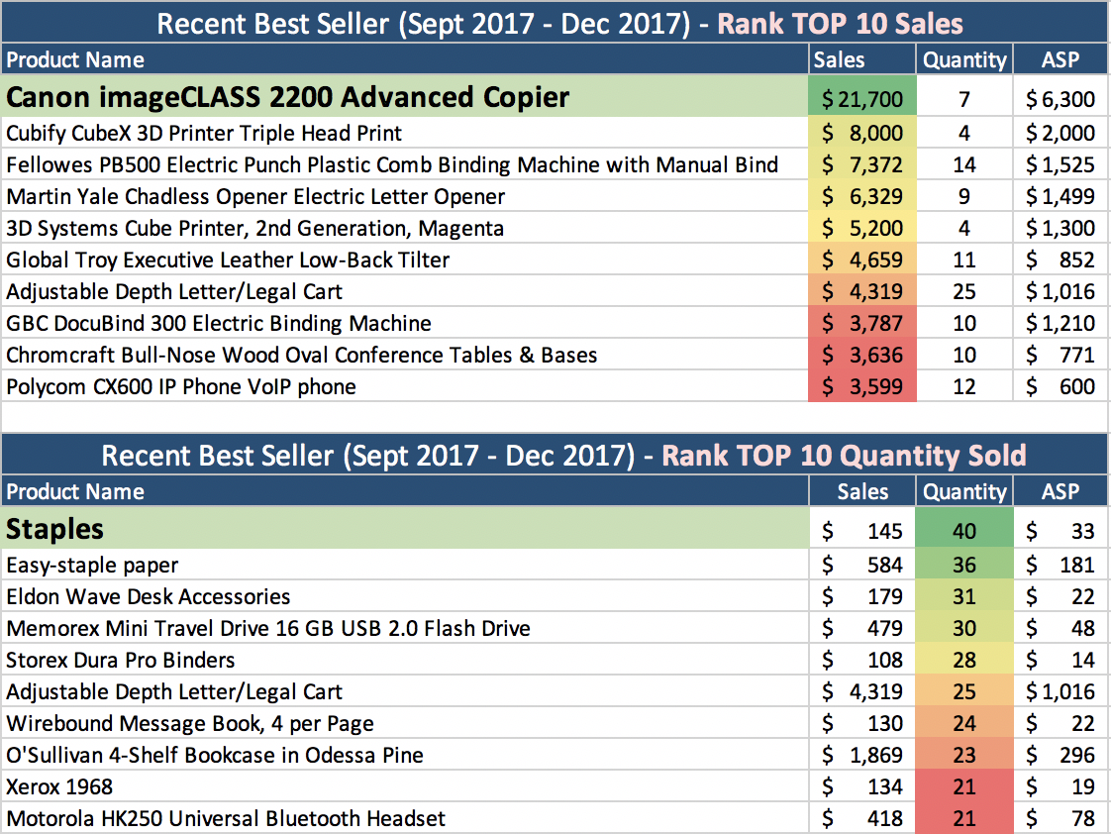
Staples is the most recent best seller with 40 units sold
Summary:
Cannon imageCLASS 2200 tops the most recent highest sales with $21k that holds 3% of the total sales from Sept to Dec 2017.
However, Staples holds the best seller as this product drives the most conversion rate in terms of visits to purchase with 40 units sold from Sept to Dec 2017.

Slide 9
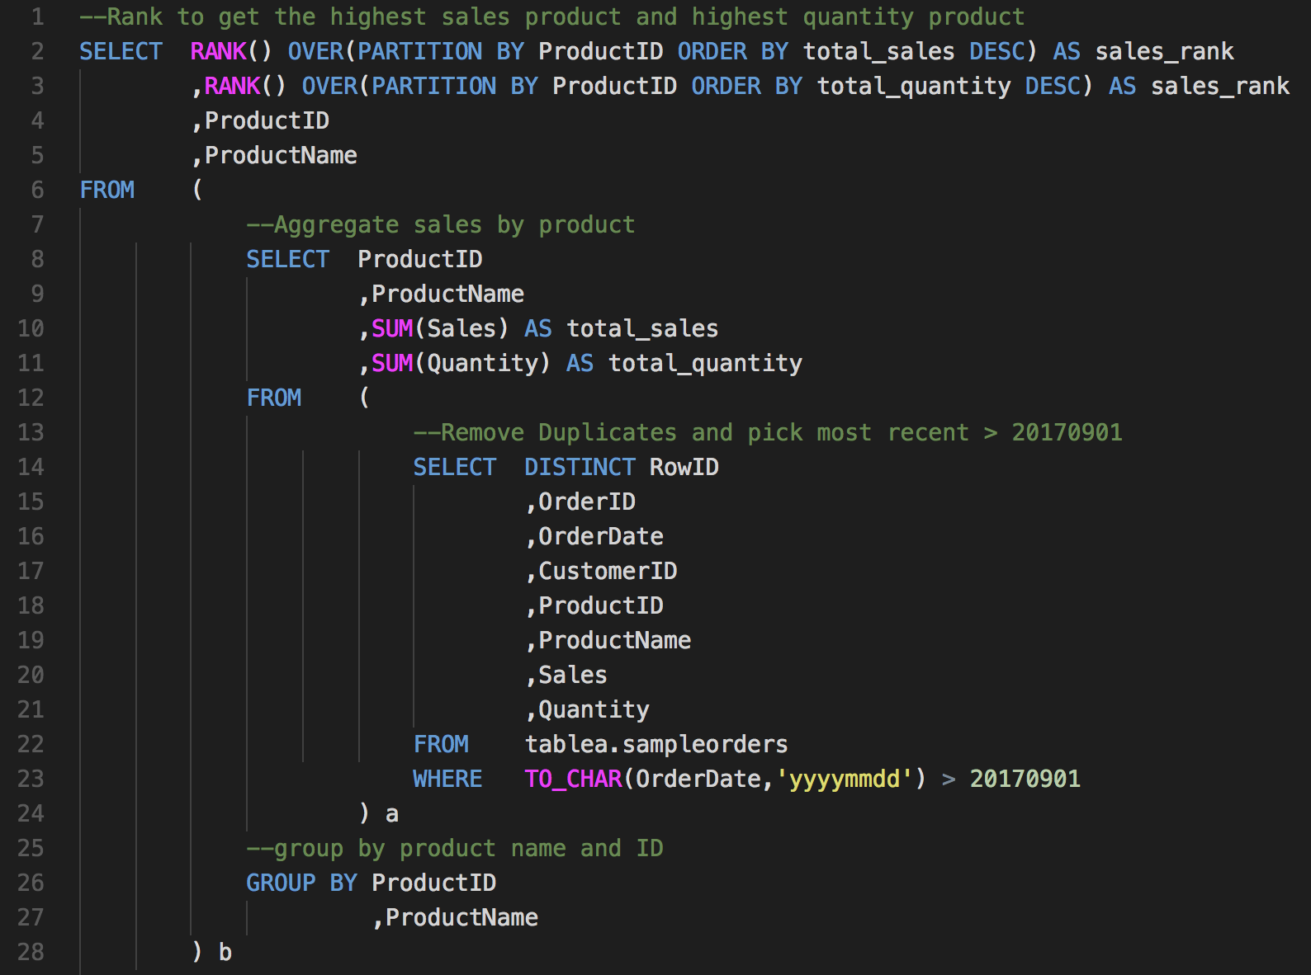
SQL for Question 2 (Part 2)
Method:
Select distinct to remove duplicates.
Select only most recent data (Last 4 months from Sept – Dec 2017). Reason to do it at this phase is to reduce computation memory and resource at the higher level of aggregation.
Aggregate sales and quantity by summing.
Rank Product by highest sales and quantity to find best selling product.

Slide 10
Question 2
Part 3
Is there any group of products which are often bought together?

Slide 11
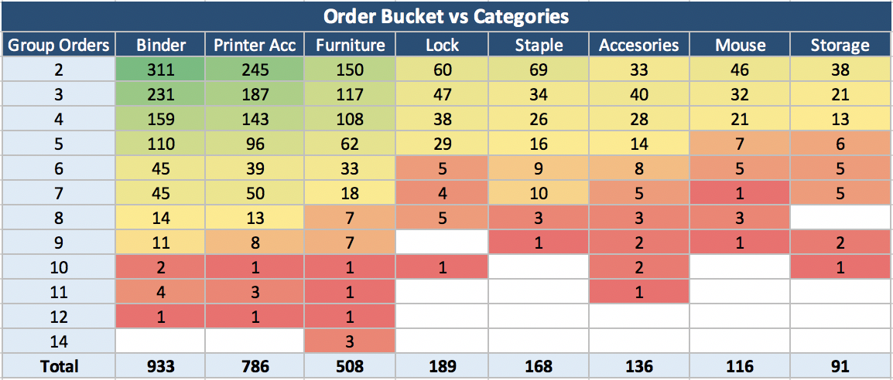
Xerox group of products are bought together with 9% amongst grouped products.
Summary:
From order bucket the category Binder and Printer holds the most products that are grouped together.
Looking at individual brand, Xerox that falls under Printer accessories holds the products that are grouped the most, covering 9% of the grouped order products.
In terms of category, customers adds Binder into their grouped products due to its low average selling price. However, this does not reflect in individual brands.
There’s no products that are consistently bought together for more than once.

Slide 12
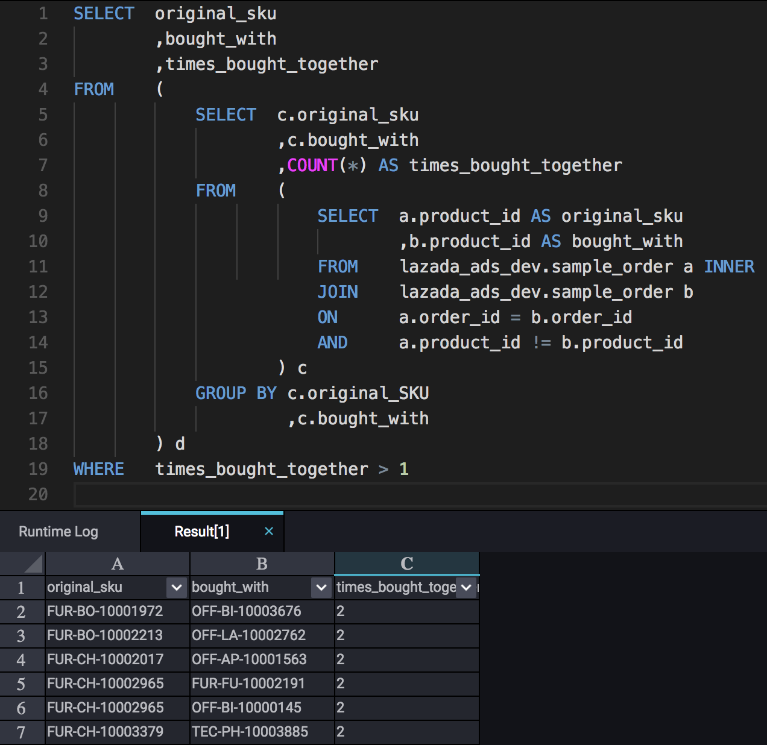
SQL for Question 2 (Part 3) – Approach 1
Method:
Inner join order id’s with the same table but with different product id. This will output two products with the same order.
Count the products and group by original product and sku that’s bought with.
Use a where condition of times bought together >1 to show if products are grouped more than once as we want to see the most grouped products.
Summary:
From this, there’s only 118 product groupings that were bought more than once.
Hence, we cant derive a conclusion based on these findings.

Slide 13
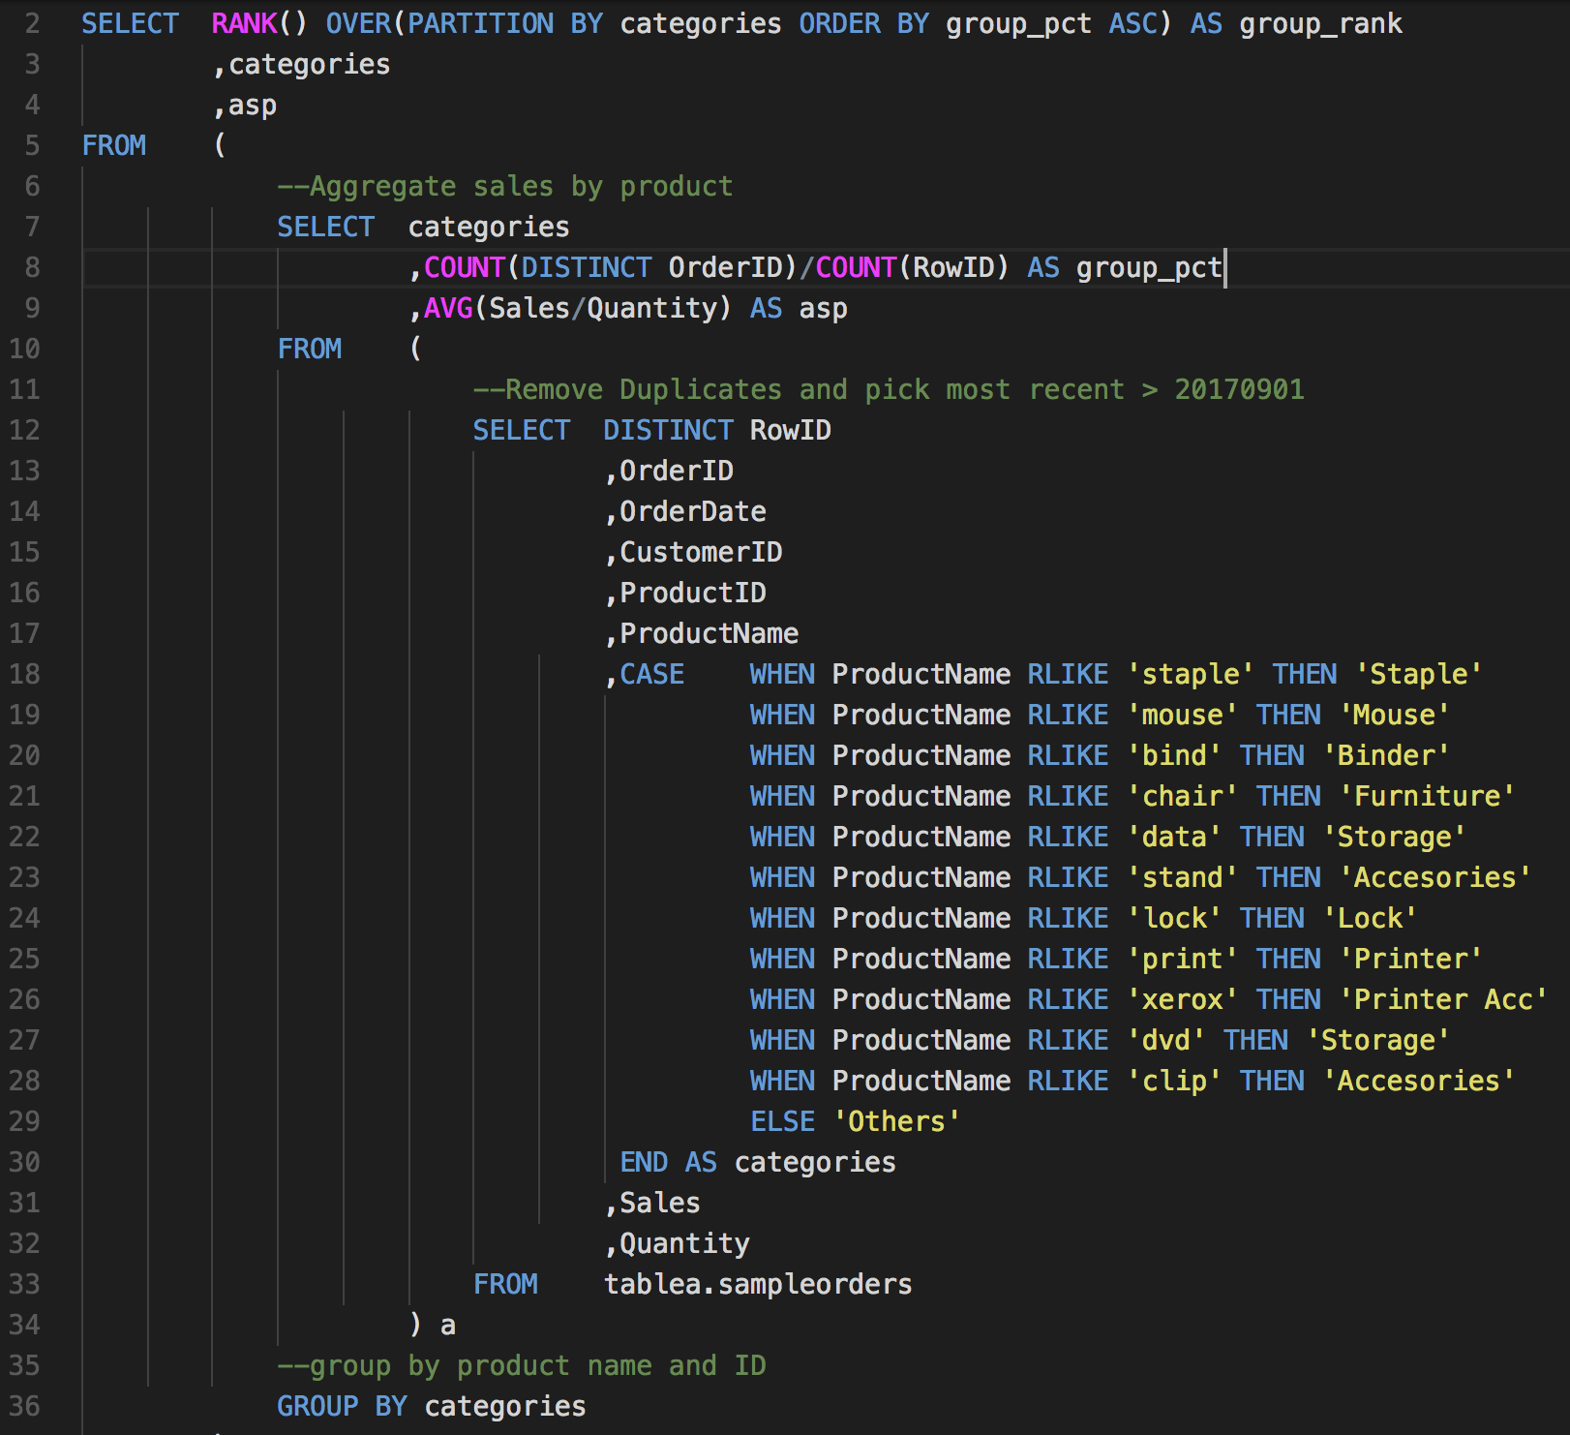
SQL for Question 2 (Part 3) – Approach 2
Method:
Select distinct to remove duplicates.
Cluster products based on categories. The approach used is finding unique product names and classifying them as a sub-category.
Group by the order per row id to find the highest percentage of products grouped. Aggregate Sales/Quantity for ASP check.
Rank categories to find most grouped product.

Slide 14
Question 2
Part 4
Is there any other insight you can get to help to improve sales number?

Slide 15
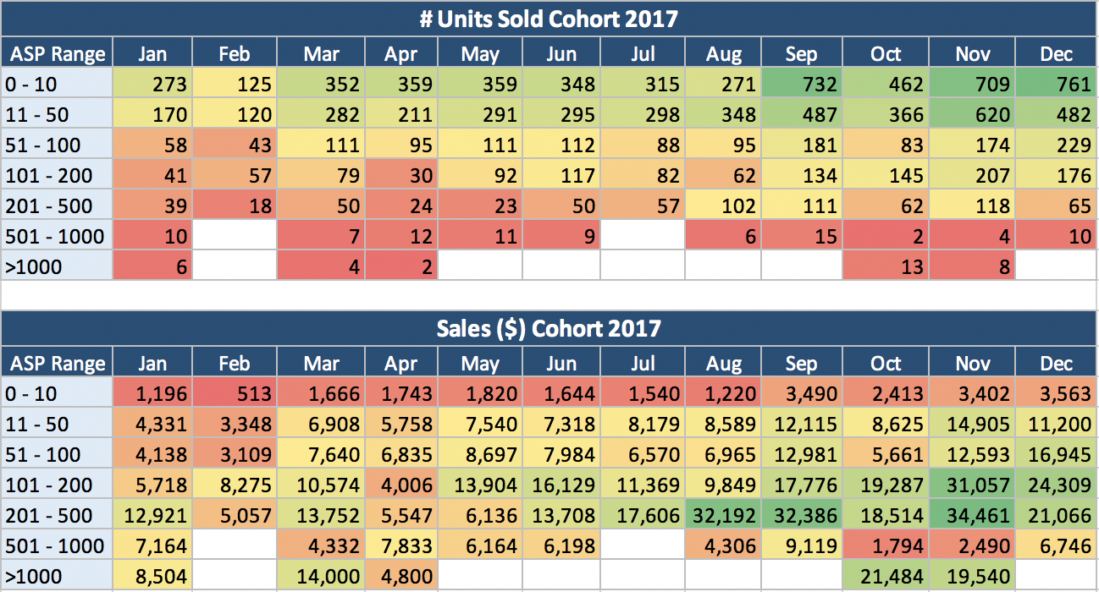
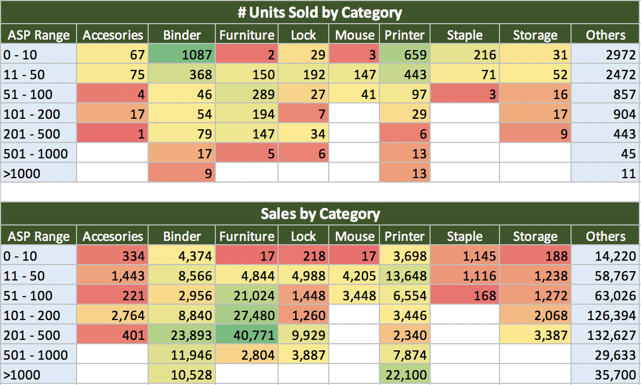
Cohort Analysis of 2017 shows most products purchased are at the lowest ASP bucket.
Cohort Analysis Summary:
Most products sold are within the Price range of below $50, however in terms of sales, those within the range of $100 - $500 holds the highest. Contribution in terms of sales comes mostly from the furniture category, which needs more push and focus.
Team should play the strategy in trying to increase the price within the competitive range for Binder, and Printer Accessories, as these products drives the most unit sold to the industry.
A mid year campaign should be established around the month of May – June, since there’s no spike in customers during that period.
Categories such as Accessories, Lock, Staple and Storage should go through a competitive check In terms of price.

Slide 16
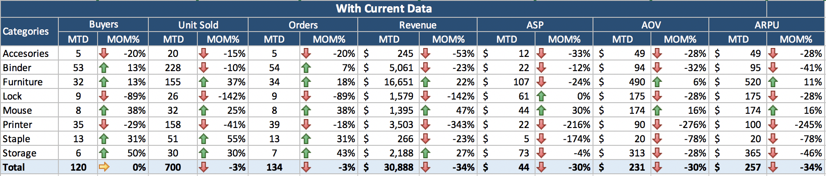
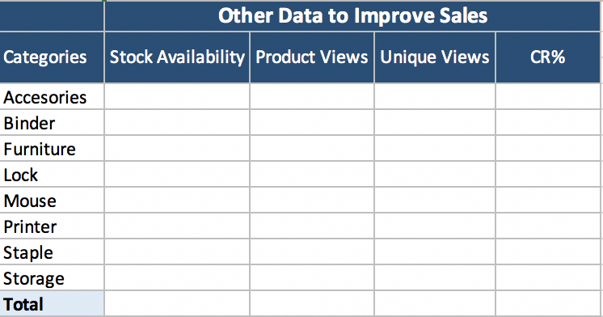
Category level Sales Funnel
Summary:
This funnel starts from Buyers, to Unit sold and Orders to Revenue.
Drop in ASP shows a rise in Buyers for categories like Binder, Furniture and Staple.
In terms of customer purchasing habits, AOV and ARPU are very similar, except for Furniture and Storage devices. Customers group buys when it comes to these categories.
Stock Availability is important as no transaction can be made if there’s no stock.
Product and unique views acts as the start of the funnel. If customers are not viewing the products, then something is wrong.
CR% or Product Views / Unit sold is a very crucial to monitor sales. A product with high CR% around 2-4% will have consistent sales throught the period.

Slide 17
Question 2
Part 5
Based on the data we have, what kind of BI dashboards you would build in order to help the sales team monitoring the performance?

Slide 18
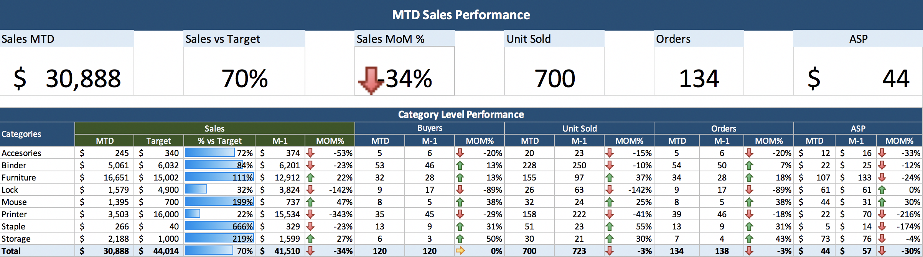
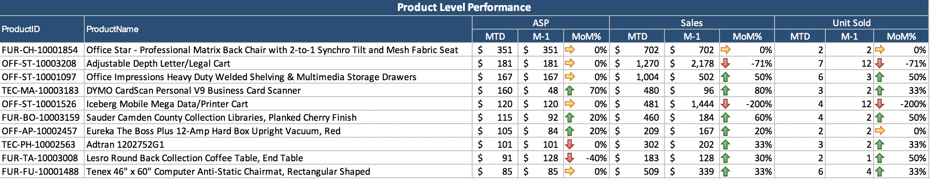
Performance Dashboard for Sales Team

